Slide 1
Software Engineering Group Projects – User Interface presentation
Author: Jor51 and adl12
Conﬁg Ref: SE.QA.04
Status: released

Slide 2
The start screen and how to proceed with the game. This will show you how to set up a game from the starting screen.

Slide 3
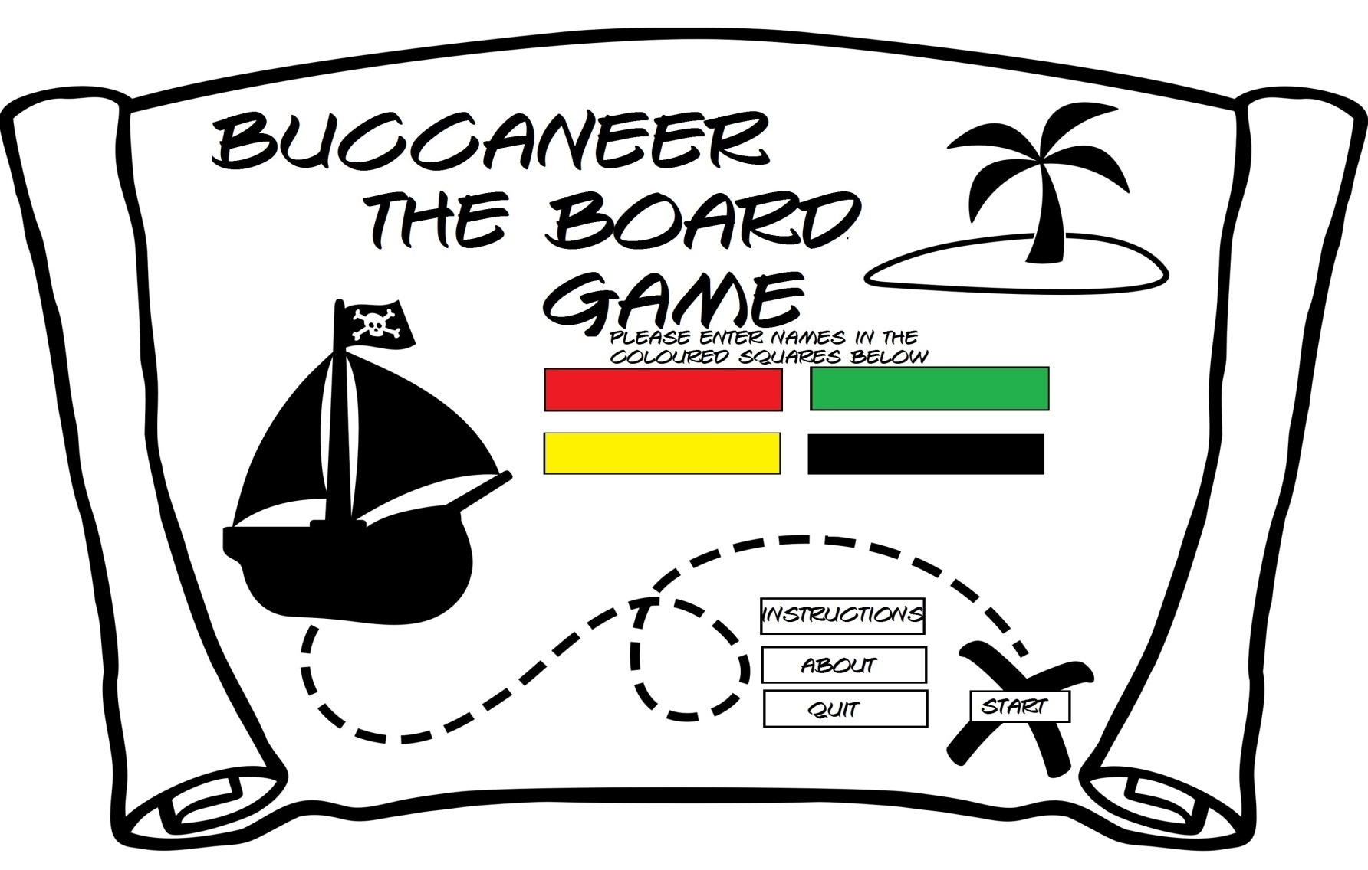
The start menu is basic with clear instructions to enter the players name in the coloured boxes.

Slide 4
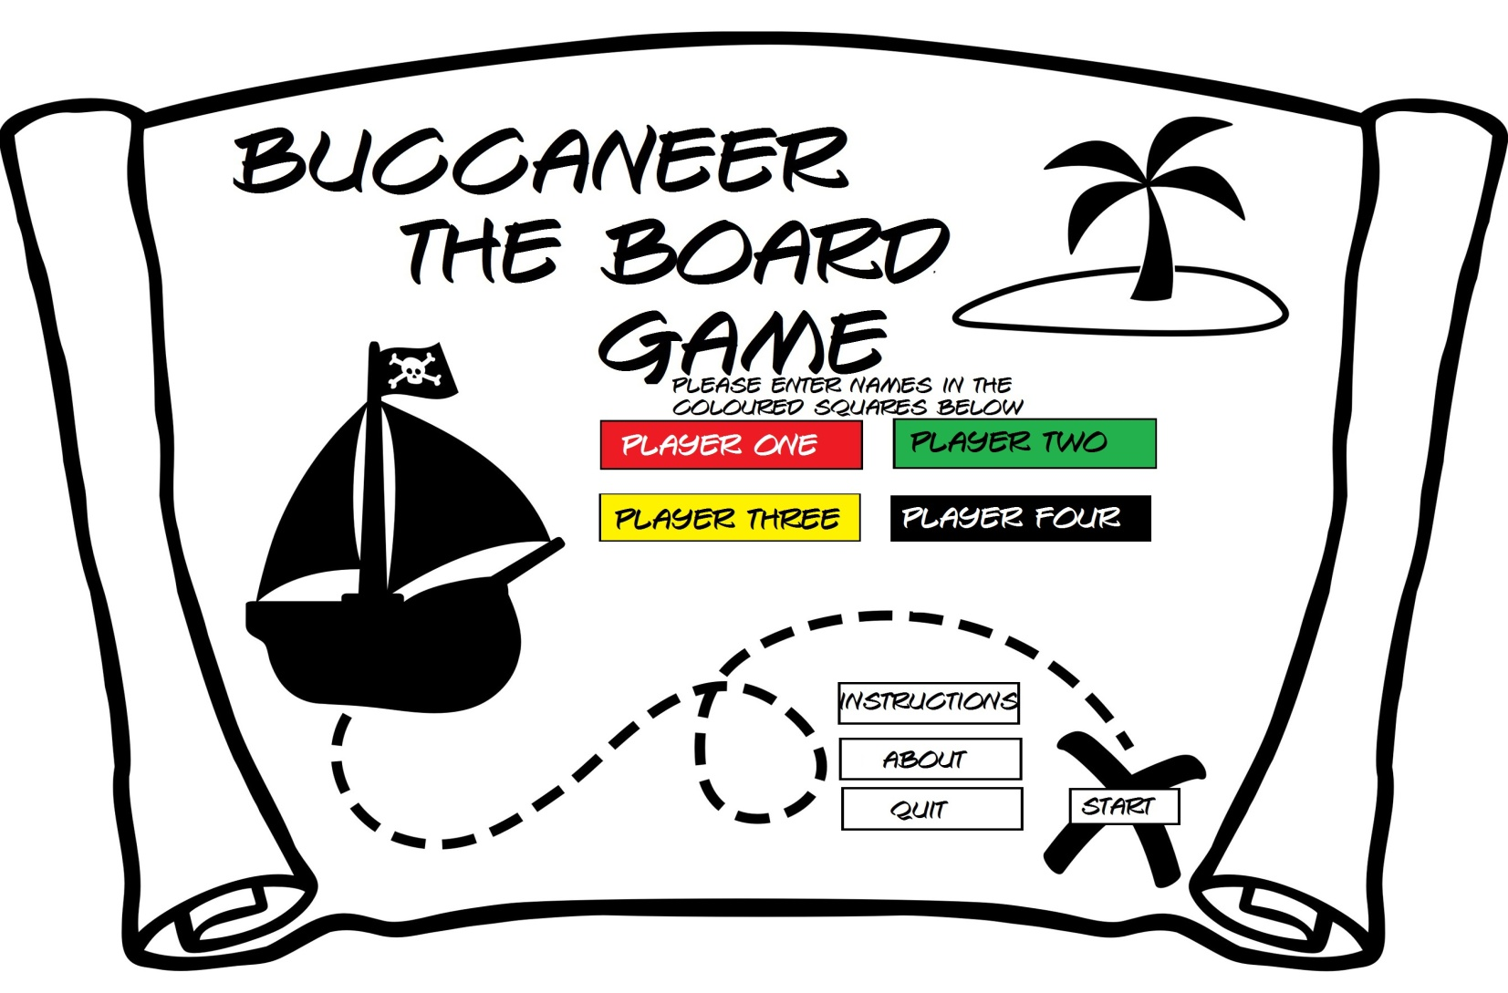
In this screen you can see that each player has entered their name. There is player one, player two, player three and player four. Once they have completed this step and clicked start. The board screen will display and the game begins.

Slide 5
A player wants to check their crew cards and then go back to making a move. This is how the GUI will handle and display the crew cards.

Slide 6
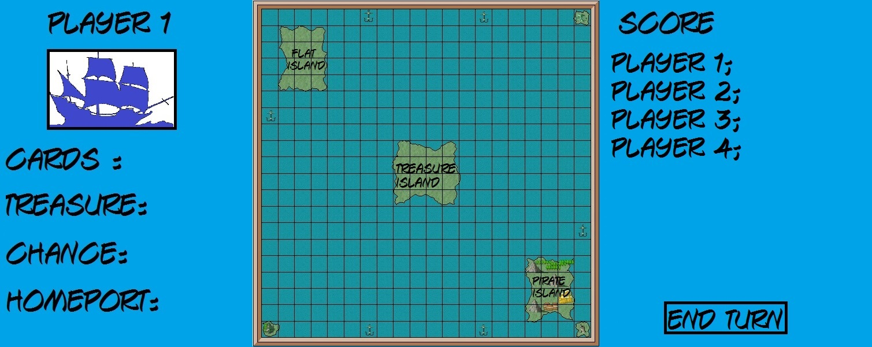









When the player is in the main board menu the user will see the cards option on the left side of the screen with the amount of cards displayed next to it.

Slide 7
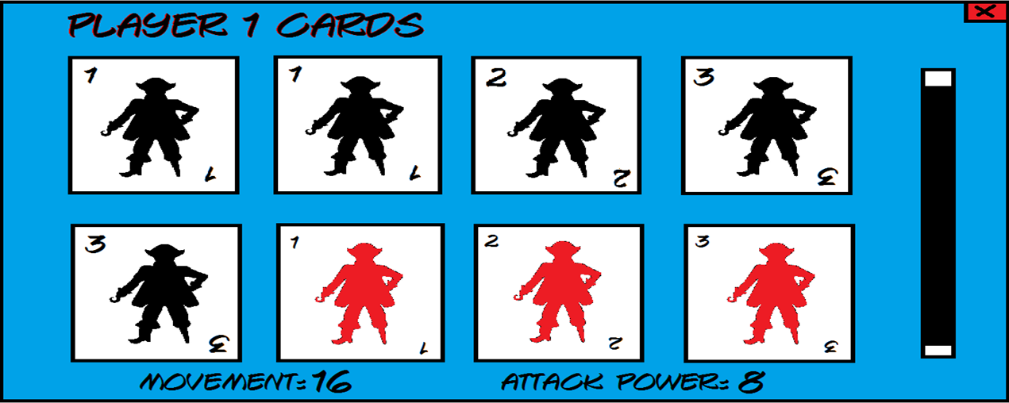
When the cards option is selected the user will be able to see all his or her crew cards with the value of both the movement and attack power. To exit click the X in the top corner.

Slide 8
Once the menu has been closed the user will go back to making their move.

Slide 9
A Player moves into a trading port and then trades 1 barrel for the equivalent in crew

Slide 10




When a player moves to a trade port a trade menu will pop up.

Slide 11
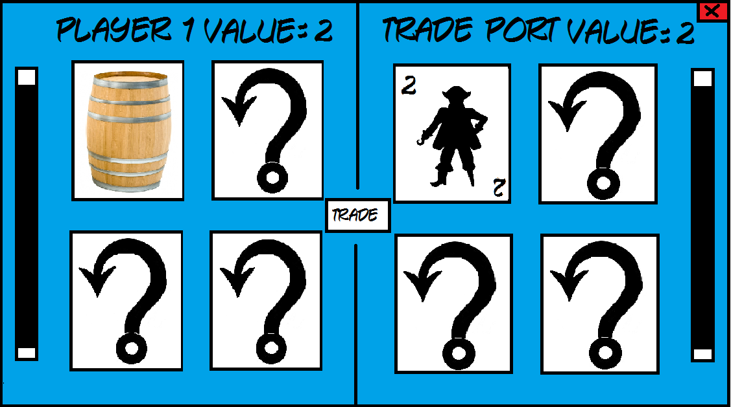
In the trade menu you will be able to select the treasure you have (a barrel) and trade it for the equivalent crew. Once the user has clicked trade it will take them back to the board screen. In the example above you can see a player swapping a barrel for a crew card worth the same amount.

Slide 12
A Player moves onto an occupied square by an enemy player ship. A battle starts and in this example the attacking player wins taking both of the loser players treasure. The loser then moves away. This is to show how the GUI works when attacking.

Slide 13

When a player moves to the same square another player is on a battle screen will pop up.

Slide 14
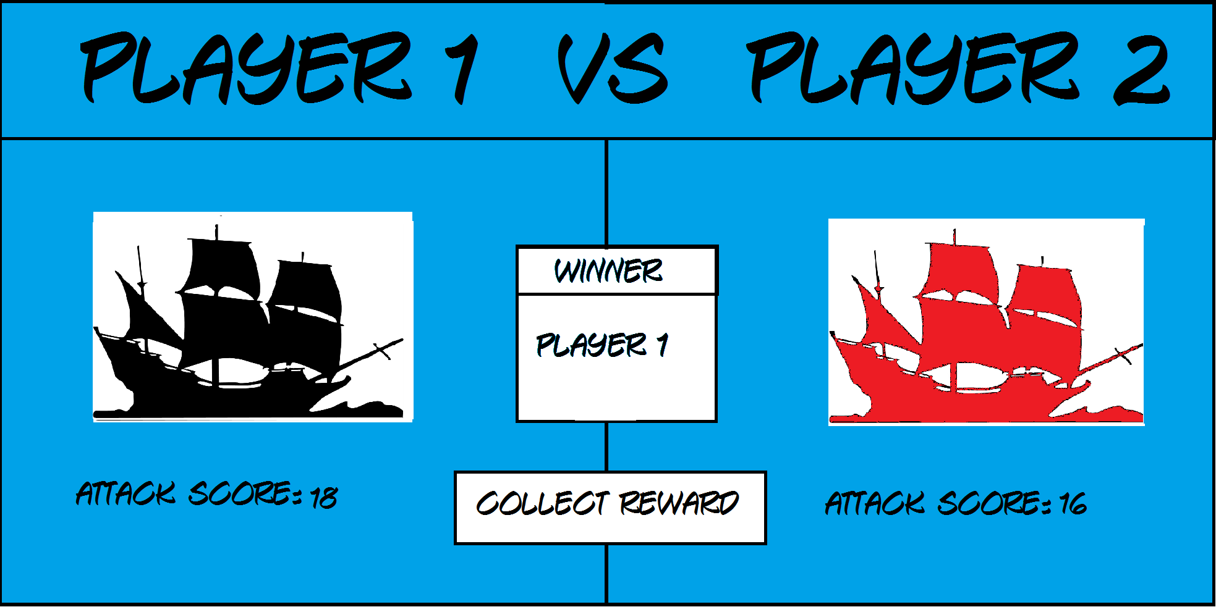
On the battle screen the users will see both the players attack score, who the winner is and the ability to collect their reward.

Slide 15
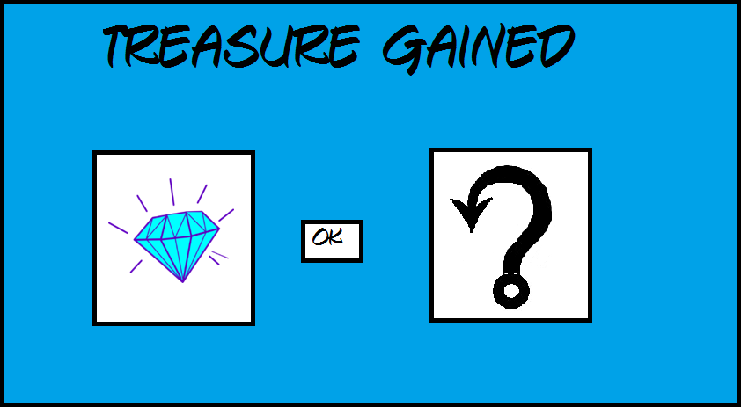
On this screen the winner has room for only 1 treasure. This shows the user gaining the highest treasure the opponent has.

Slide 16
A message will prompt the user that the remaining treasure has gone to treasure island.
All remaining treasure has gone to treasure island!
Ok

Slide 17
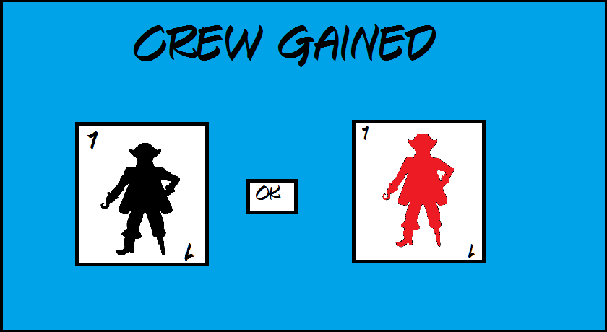
If the loser does not have treasure, but does have cards, then the two lowest value cards in the loser's hand are given to the winner.

Slide 18
A message will prompt the loser (player 2) that they have to make a free legal move away from the winners ship.
Can player 2 please make a free move away from the
other ship!
Ok

Slide 19



The loser must move up to the maximum squares that they can move, in any direction, followed by a change of direction. They must move at least one square away from the attacker. In this picture the user can move up to 3 squares. If the result is a draw no treasure or crew cards are lost as a result of the battle, however the attacking ship gets to make a free move and direction change.

Slide 20
A Player moves to the coast of treasure island and get given a chance card. The chance card gives him the choice of either a treasure or 3 crew cards. The user then proceeds to pick a treasure gain a diamonds.

Slide 21
The user proceeds to the coast of treasure island.

Slide 22
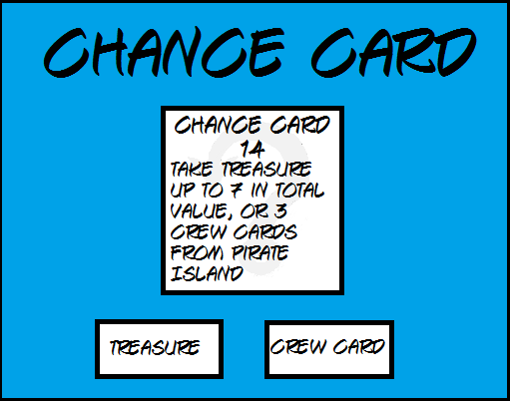
The player gains the chance card 14 and gets the option between treasure and crew cards. The player then proceeds to picks treasure

Slide 23
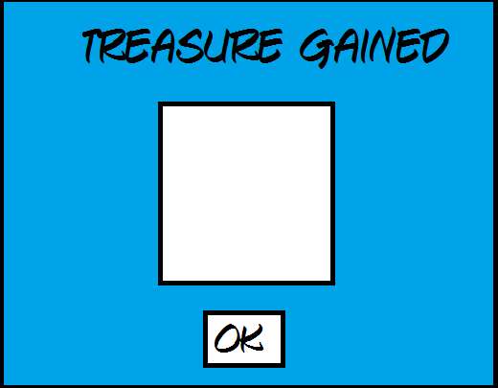

The player then gets a pop up prompting him that he has just gained his treasure (a diamond).

Slide 24
A Player gets given a chance card they can keep, they then click the chance card button to see the card they've been given (card 25 in this example).

Slide 25
When the player is in the main board menu the user will see the Chance option on the left side of the screen with the amount of chance cards they have displayed next to it.

Slide 26
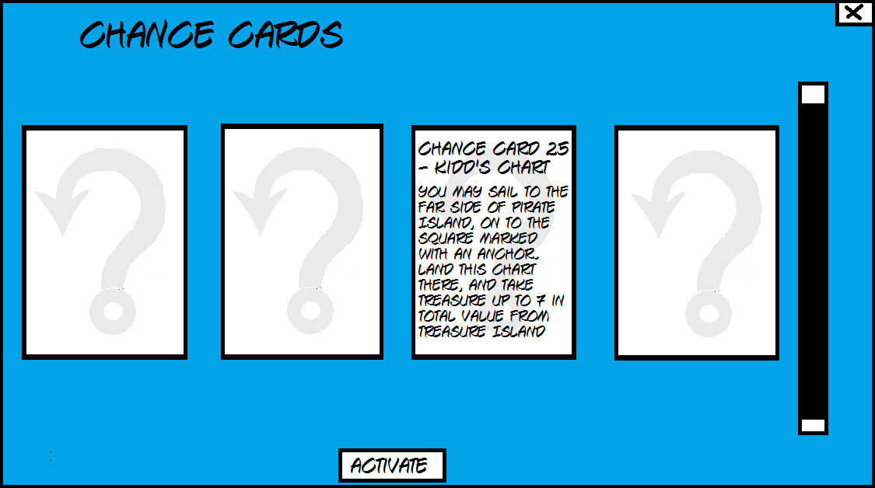
Once the user has selected the chance option, the chance menu will pop up displaying all the chance cards they have gained. As you can see this player has the chance card 25 – Kidd’s Chart.

Slide 27
Player moves a distance and then changes direction. This is to show how movement works with the GUI.

Slide 28
The board highlights the squares the player can move to and change the direction of the ship to.
The player clicks the highlighted square 3 away from their ship to move to

Slide 29
The board highlights the squares the player can change direction to.
The player clicks the square to the left of them.

Slide 30
The board changes the direction of the players ship to the new direction.

Slide 31
Player is their home port and wants to move out of the port.

Slide 32
The board highlights all of the squares the player can to out of their port.
The player clicks the highlighted square the maximum distance in the south west direction

Slide 33
The board highlights the squares the player can change direction to.
The player clicks the highlights square to the south of them

Slide 34
The board changes the direction of the players ship to the new direction.

Slide 35
The player moves into their home port and deposits the treasure that they have.

Slide 36
The board highlights the squares the player can move to and change the direction of the ship to.
The player clicks the highlight square to enter their home port

Slide 37
The board moves the player into their port and changes their direction to face out of the port. All of the treasure the player had in their ship is deposited into their port and the score of that treasure is added to the players score.

Slide 38
The player moves past another player and the second player get the option to attack them.

Slide 39
The board highlights the squares the player can move to and change the direction of the ship to.
The player clicks the highlighted square at the maximum of their movement distance.

Slide 40
Player 2 Would you like to attack Player 1?
Yes
No
The Programs gives the player being passed the option to attack the player who is passing them.
The player clicks no.

Slide 41
The player is allowed to pass the other player so the board moves their ship to the intended location

Slide 42
Player deposits enough treasure in their home port to win.

Slide 43

The Player moves into their port to deposit treasure

Slide 44
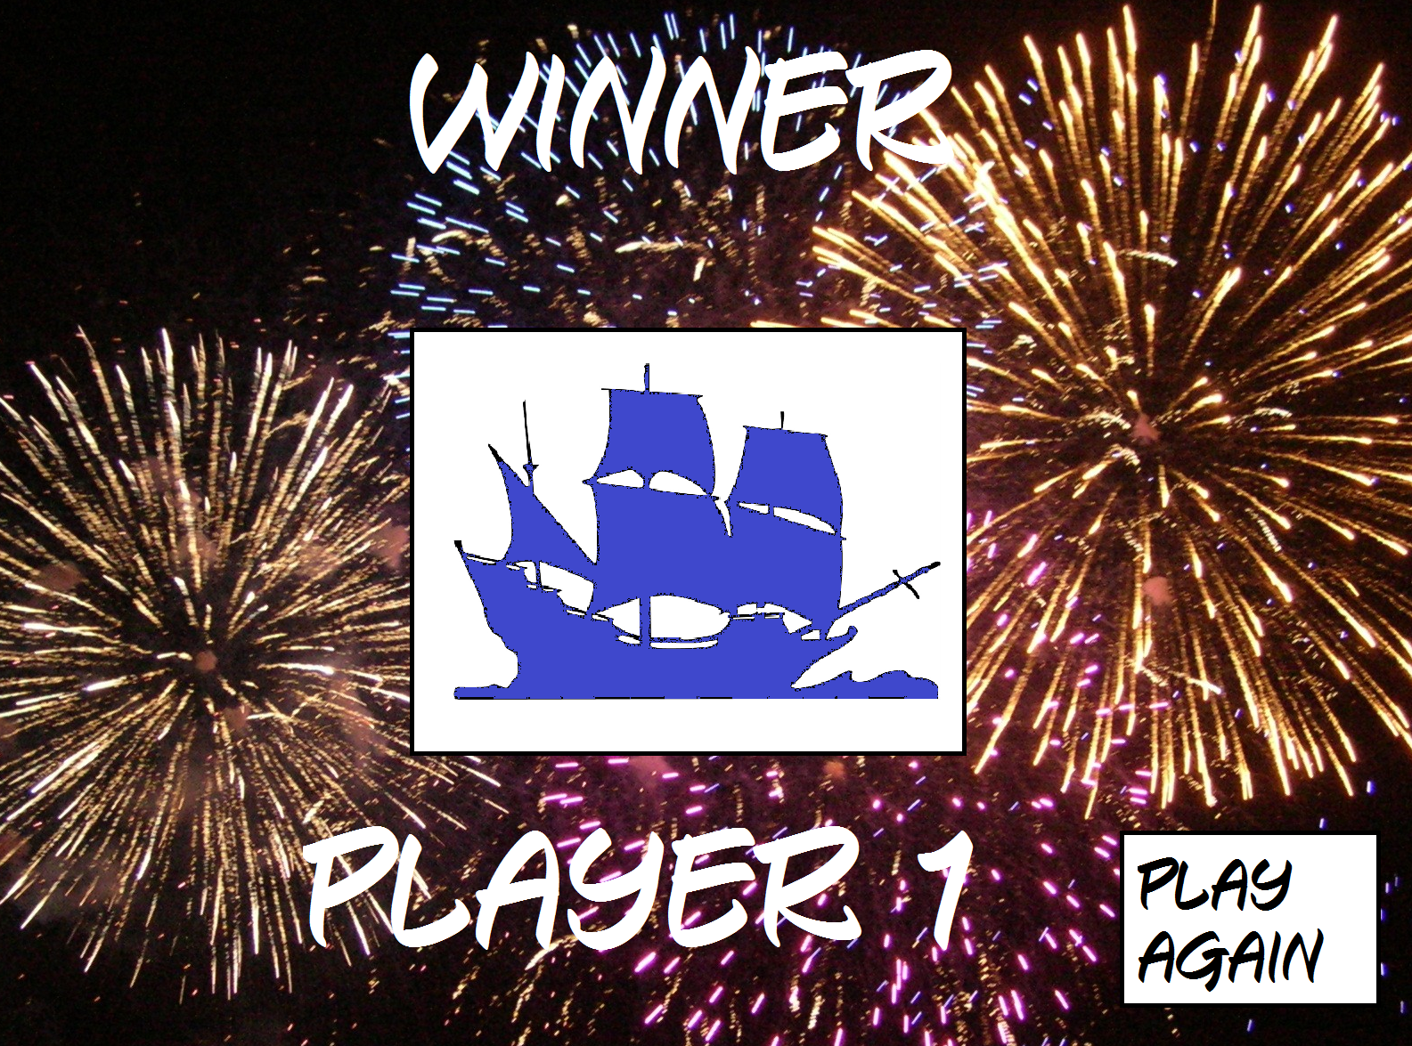
The victory screen will show with the player being the victor

Slide 45
The Player moves to the coast of flat island and get awarded with the crew cards and treasure.

Slide 46
The board highlights where the player can move to.
The player clicks the highlighted square adjacent to flat island.

Slide 47
The board moves the player to the edge of flat island.

Slide 48
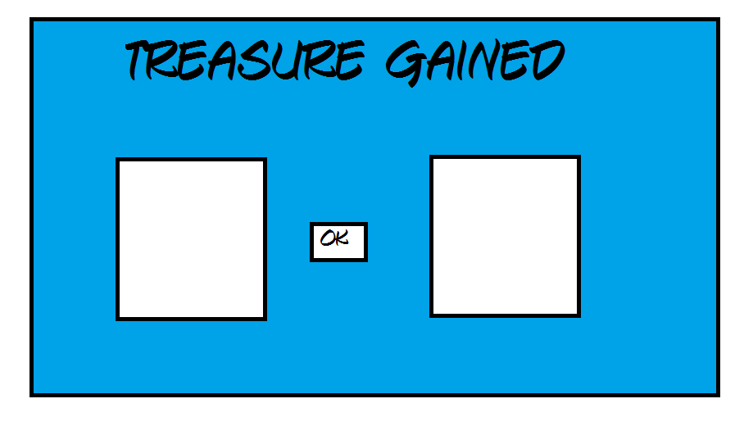
The player is awarded all the treasure they can hold from flat island and all the crew cards in this case 2 pieces of treasure and no crew cards.

Slide 49

The rewards are given to the player.

